Slide 1

CORNER AND EDGE FUSION FOR BARCODE REGION LOCALIZATION
Course Code:DSA0205
Computer Vision with OpenCV
Guided By: Presented By:
Dr.A.Narenthirakumar Y.Bhavya Sri

Slide 2

INTRODUCTION
Corner and Edge Fusion for Barcode Region Localization
Barcode region localization is the process of identifying the exact location of a barcode within an image before decoding its information.
In real-world images, barcodes may appear with different sizes, orientations, lighting conditions, backgrounds, and levels of noise, making detection challenging.
Edge detection identifies sudden changes in intensity and is useful because barcode patterns contain many closely spaced edges.
Corner detection identifies important points where image structures change direction, helping to identify the boundaries and shape of the barcode region.
The proposed approach combines (fuses) corner and edge information to obtain stronger and more reliable features for identifying barcode regions.
After localization, the detected barcode region can be extracted as a Region of Interest (ROI) and passed to a barcode decoder.

Slide 3
OBJECTIVES
Objectives of the Proposed System
To detect barcode features Identify important edge and corner features present in the input image.
To combine edge and corner information Fuse both feature types to obtain stronger structural information about the barcode.
To identify the barcode region Distinguish the barcode from other objects and background regions in the image.
To accurately localize the barcode Generate a bounding box or Region of Interest (ROI) around the detected barcode.
To improve detection reliability Reduce incorrect detections by using multiple complementary visual features.
To support barcode decoding Provide a correctly localized barcode region as input to the decoding stage.

Slide 4
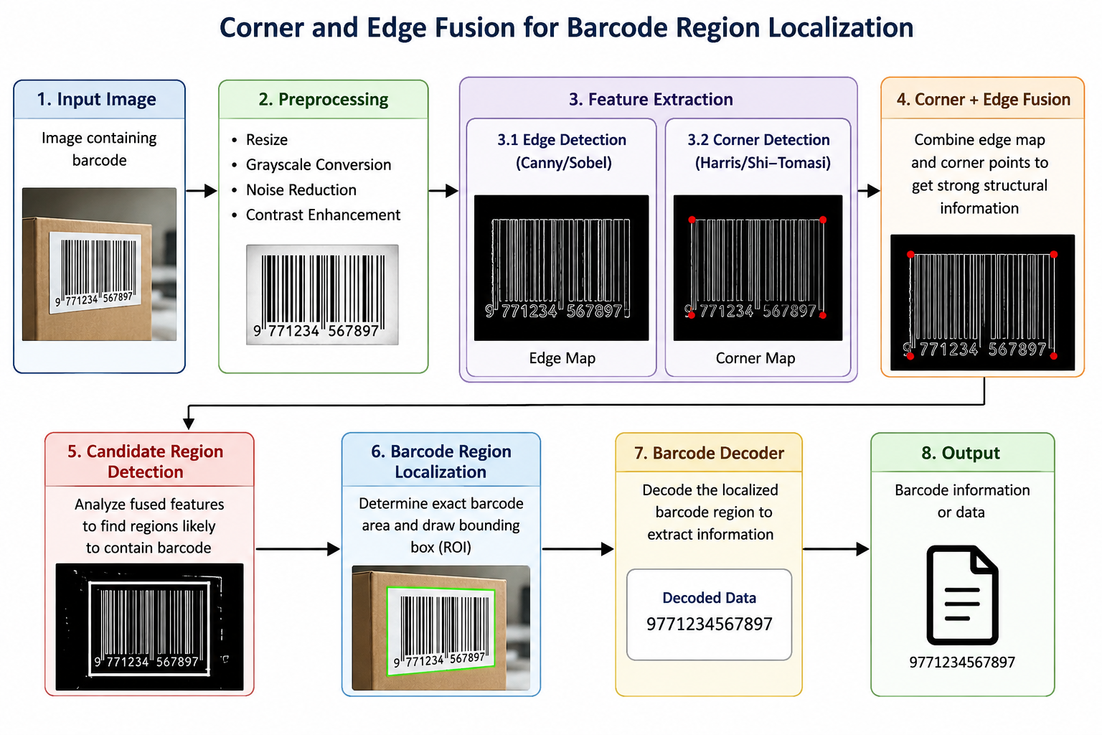
SYSTEM ARCHITECTURE

Slide 5
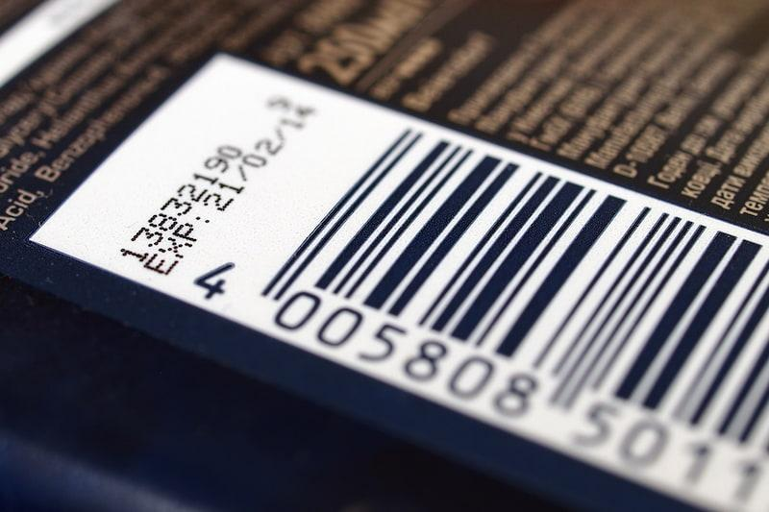
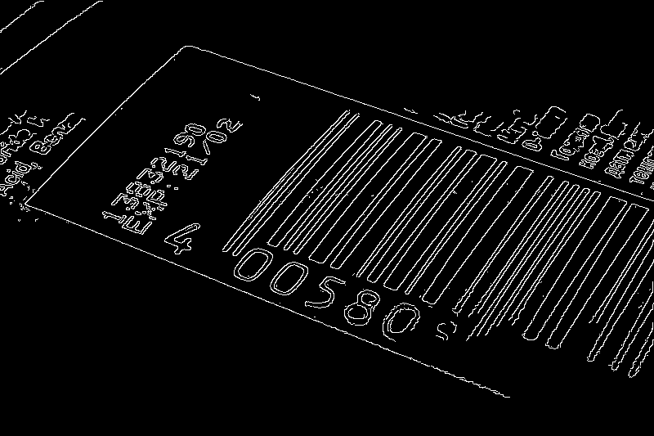

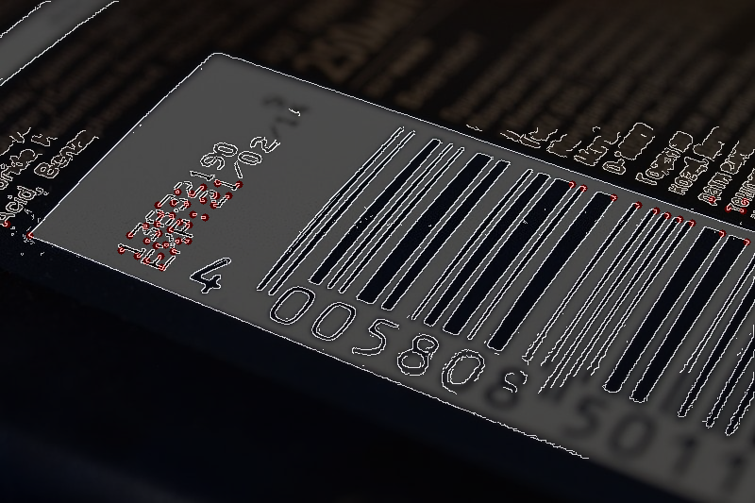
OUTPUT:
Original Image
Edge Detection
Corner Detection
Corner + Edge Fusion

